Slide 1
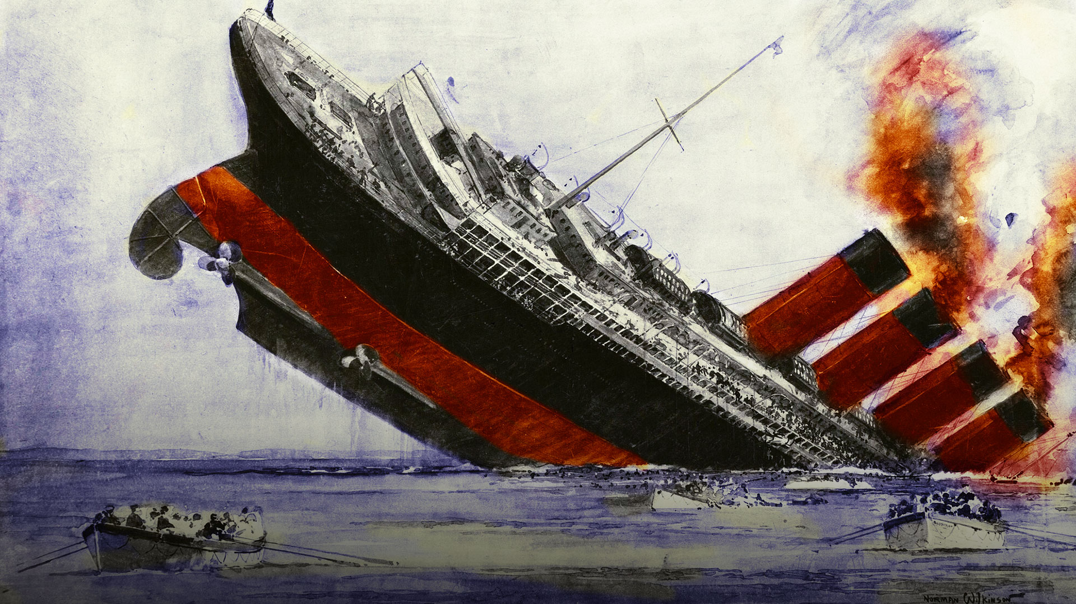
Mike Stammers Memorial Lecture
Wednesday, 7 May 2025, 5:30 p.m
Museum of Liverpool, L3 1DG
‘The sinking of the Lusitania: Misfortune or murder?’
by
Peter Elson
The catastrophic sinking of the Liverpool-bound Cunard superliner Lusitania, exactly 110 years ago to the day of this illustrated talk, has been overshadowed in the public mind by the spectacular tragedy of her White Star Line transatlantic rival Titanic.
In reality, the loss of Lusitania three years after Titanic was vastly more important, not only changing the course of the First World War but of global warfare from the fateful 7 May 1915 as this famous ship, filled with 1,960 civilian souls was torpedoed by the German submarine U-20.
But why was a passenger liner steaming through a warzone, ready prey for the invisible U-boat threat? Was it incompetence? Ignorance of the rapidly changing rules of engagement? Or was it more complex and sinister, with Germany believing she was carrying illegal arms to Britain and therefore a legitimate target?
Or worse, was it a plan by the man regularly hailed as the ‘Greatest Briton of All Time’ – Winston Churchill – to lure the US into the war, prompted by the death toll of American passengers?
Free Lecture: All welcome

