Slide 1
Managing Student Progression
Academic Registry

Slide 2
What will we cover today?
Student Progression
Academic Framework (key points)
Mark Finalisation and Module Verification (Semester 1 Modules)
Personal Tutorial: Assessment Performance
Programme Performance Meetings
Boards of Examiners (standard provision only)
June Boards of Examiners Referral requirements and timeline
July Referral Boards of Examiners
Exchange student management

Slide 3
Student Progression:
attain all required credit at first attempt (Level Completion or Award)
or
attain all required credit at second attempt (Level Completion or Award)
or
attain 100 / 96 credits and proceed ‘trailing’ 20 / 24 credits
or
undertake a ‘Final Module Attempt’ *
student entitled to ‘FMA’ if 60 credits attained, may be permitted ‘FMA’ by the Board if 60 credits not attained
FMA requires attendance

Slide 4
Before Teaching commences on a Module
All assessment and reassessment tasks must be internally reviewed and approved by the External Examiner prior to the commencement of teaching.
Referral assessment requirements must be published prior to the delivery of the module via the module guide
Assessment component to be completed (e.g. essay, report, exam). If a single synoptic task is to be completed for the module this must be clearly stated.

Slide 5
What is Module Mark Verification?
Mark verification (WebHub)
Completing the Module Verification Tool (MVI) you are confirming:
Internal moderation has occurred per the Moderation Policy
External Moderation has occurred and is confirmed
Module marks are complete and accurate
Following MVI completion and administrative posting of marks, these marks are transferred immediately onto the student transcript

Slide 6
What is Module Mark Finalisation?
Mark Finalisation
All marks must be finalised, verified (via WebHub) and entered onto SIS by the ultimate deadline of the 8th February 2019.
Mark verification must be completed prior to this date to provide confirmation that the marks are correct before Administrative staff post marks
Mark posting generates student transcripts
18th Feb – All Semester 1 marks available to students
All Referral work details Course work specs available on Canvas by 9am on Feb 18th

Slide 7
Personal Tutorial
Students marks are displayed on their online transcript (accessible by LJMU Portal).
A one to one personal tutorial (with students personal tutor) must be completed by the 8th March
What can personal tutors see?
How do personal tutors know the referral requirements- Canvas Module Guide

Slide 8
WebHub- Student Transcript
If they’ve been identified as a personal tutor on SIS, they will have access to the transcript and results statement for their personal tutees.
If identified as a programme leader on SIS, they will have access to the transcript and results statement for all students on their programme.

Slide 9
Personal Tutor View
Clicking on either ‘Programme Leader Student List’ or ‘Personal Tutor Student List’ tab will expand to show students. Clicking the results button for any student display a link to the results statement and progress transcript (if one is available).

Slide 10
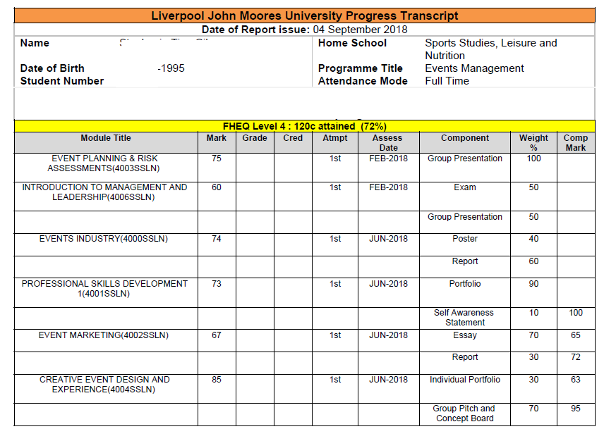
The New Transcript
This is a draft of the new transcript
Similar to existing transcript without the grade category column stating ‘PASS or FAIL’ and credit attained column.

Slide 11
Communication
Students
Students informed of Results transcript availability
Requirement for students to access transcript and prepare for tutorial meeting- message from Programme Team/Personal tutor
Programme Teams
Personal tutors will receive a system generated email identifying tutees who have a failing mark entered onto SIS in a Semester 1 module
Programme Leaders will receive a system generated email identifying students who have a failing mark in an ESR / FMA in a Semester 1 module
Programme leaders will need to advise these students that they can not achieve their target award but can complete Semester 2 modules to achieve credit ONLY

Slide 12
Programme Performance Meeting
The posting of marks also leads to the generation of reports for consideration at the programme performance meeting.
The reports and minutes from the meeting can then be used within subsequent stages of the Continuous Monitoring and Enhancement (CME) process.
The programme performance meeting must be held by 8 March 2019.
What Reports??
Programme Performance Reports
Any other reports Programme teams would like to include as relevant

Slide 13
Boards of Examiners
No changes to operation of BoE
Board of Examiner deadline is 7th June 2019
Results Notification Day is 17th June 2019
The reassessment period for referred and deferred students is timetabled for the week prior to graduation, week beginning 1st July 2019, the coursework submission deadline is 5th July 2019.
Should Boards be allowed to given Dissertations longer period (i.e to hit MSc final board)? For NATs / New Data Collection required?

Slide 14
July Boards of Examiners Referral requirements and timeline
Marks need to be finalised by the 19th July
Board of Examiners deadline is the 25th July
Results Notification Day is 31st July
10 day turnaround from Results notification until reassessment period
Transparency of referral requirements of fundamental importance

Slide 15
Questions and Queries?

